Slide 1
The UNIX File System
Harry Chen
Department of CSEE
University of MD Baltimore County

Slide 2
Introduction
What is File System?
  The abstraction used by kernel to represent and organize the storage resources.
UNIX File System in general
  File system is organized in tree structure.
  File tree can be arbitrarily deep.
  File name must NOT LONGER than 256 chars.
  Single path name must NOT LONGER than 1023 chars.

Slide 3
Creating File System
Mounting File System
  File tree is composed of File System
  Use mount command to map a directory within the existing file tree (mount point) to the root of the new file system.
    mount /dev/hda2 /usr
  Use umount command to detach the file system.
    Detaching will fail if the file system is busy.

Slide 4
Organizing of The File System
“The UNIX file system has never been very well organized.” incompatible naming convention
    e.g. ATT & BSD startup script naming
    e.g. log file naming

Slide 5
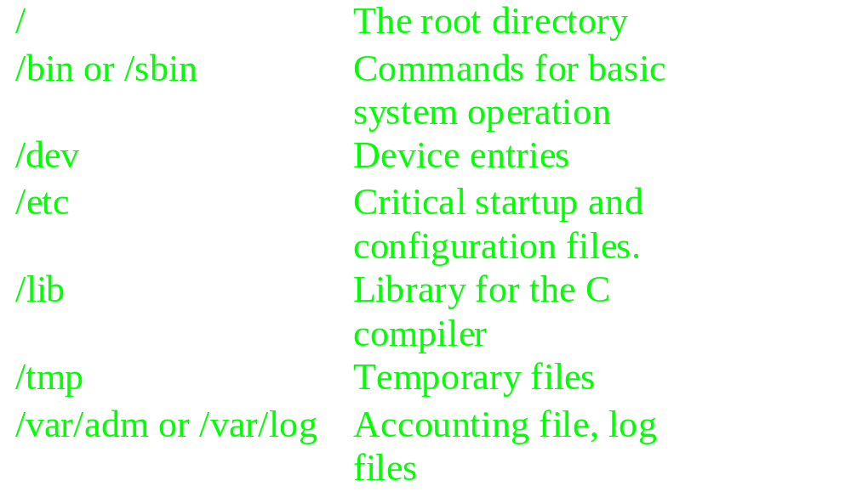
Organizing of The File System (cont.)

Slide 6
Types of Files
Regular Files
  binary
    GIF, JPEG, Executable etc.
  text
    scripts, program source code, documentation
  Supports sequential and random access

Slide 7
Types of Files (cont.)
Directory
  Can contain ANY kind of files
  what is “.” and “..”??
Device File
  Allows programs to communicate with hardware.
  Kernel modules handles device management.

Slide 8
Types of Files (cont.)
Device Files (cont.)
  Character Device
    Accepts a stream of characters, without regard to any block structure.
    It is not addressable, therefore no seek operation
  Block Device
    Information stored in fixed-sized block
    It is addressable, therefore seek operation is possible.

Slide 9
Types of Files (cont.)
UNIX Domain Sockets (BSD)
  sockets that are local to a particular host and are referenced through a file system object rather than a network port.
  X windows
Named Pipe
  Allow processes to communicate with each other.

Slide 10
Types of Files (cont.)
Hard links
  Linking files by reference
  System maintains a count of the number of links
  Does not work across file systems.
Soft links
  Linking files by name
  No counter is maintained
  Work across file system

Slide 11
File Permissions
The Setuid and Setgid bits
  Setuid with octal value 4000
  Setgid with octal value 2000
  These bits allow programs to access files that processes that would otherwise off limits to the user that runs them.

Slide 12
Types of Files (cont.)
Sticky Bit
  Not very popular in today’s system
  If a directory has sticky bit set, then only the owner can remove file from the directory.
  /tmp is a good example.

Slide 13
Types of Files (cont.)
The Permission Bit
  9 permission bits used to determine 3 types of accesses, READ, WRITE, EXECUTE.
  Permission can be set based on GROUP, OWNER, ANYONE ELSE.
  Use chmod command to change permission
    Binary 001 for EXECUTE
    Binary 010 for WRITE
    Binary 100 for READ

Slide 14
Types of Files (cont.)
INODES
  Kernel maintains file information in a structure called inode.
    Creation, modification time stamps
    Ownership, file size etc.
  Commonly used INODE information can be found by using ls command
  Group information and be modified by using chgrp command.

Slide 15
Summary
All UNIX file system are very similar.
All file system have this concept of file tree.
  Transparent to user even mount point is mapped to a remote file system.
To communicate with devices, special device files are used.
More information check out the man pages.

